Slide 1
Database Management Concepts
IICT
Anoud Abdullah

Slide 2
INTRODUCTION
A database is a collection of related data which represents some aspect of the real world.
A database system is designed to be built and populated with data for a certain task.

Slide 3
WHAT IS A DATABASE?
Database is a organized collection of data. For example a database of a college would be having a collection of data such as – 1. Personal records of Students 2. Students performance history 3. Teachers data 4. Financial department data etc.

Slide 4
Introduction to DBMS
DBMS stands for Database Management System.
A database management system (DBMS) refers to the technology for creating and managing databases.
DBMS is a software tool to organize (create, retrieve, update, and manage) data in a database.
MS. ACCESS is one of the most common examples of database management software.

Slide 5
WHAT IS A DBMS?
A database management system is a software application which is used for managing different databases. It helps us to create and manage database. With the help of DBMS we take care following tasks – 1. Data Security 2. Data Backup 3. Manages huge amount of data 4. Data export & import 5. Serving multiple concurrent database requests 6. Gives us a way to manage the data using programming languages.

Slide 6
AIM OF A DBMS
The main aim of a DBMS is to supply a way to store up and retrieve database information that is both convenient and efficient.
By data, we mean known facts that can be recorded and that have embedded meaning.
A datum is a unit of data. Meaningful data is combined to form information.
Hence, information is interpreted data - data provided with semantics.

Slide 7
DATA, INFORMATION & KNOWLEDGE
Knowledge refers to the useful use of information.
Information can be transported, stored, and shared without any problems and difficulties, but the same cannot be said about knowledge.
Knowledge necessarily involves personal experience and practice.

Slide 8
More about Database Systems
Database systems are meant to handle an extensive collection of information.
Management of data involves both defining structures for storage of information and providing mechanisms that can do the manipulation of those stored information.
Moreover, the database system must ensure the safety of the information stored, despite system crashes or attempts at unauthorized access.

Slide 9
Popular DBMS Software
Here, is the list of some popular DBMS system:
MySQL
Microsoft Access
Oracle
PostgreSQL
dBASE
FoxPro
SQLite
IBM DB2
LibreOffice Base
MariaDB
Microsoft SQL Server etc.

Slide 10
Why use dbms?
To develop software applications in less time.
Data independence and efficient use of data.
For uniform data administration.
For data integrity and security.
For concurrent access to data, and data recovery from crashes.
To use user-friendly declarative query language.

Slide 11
Where dbms is being used?
Airlines: reservations, schedules, etc
Telecom: calls made, customer details, network usage, etc
Universities: registration, results, grades, etc
Sales: products, purchases, customers, etc
Banking: all transactions etc

Slide 12
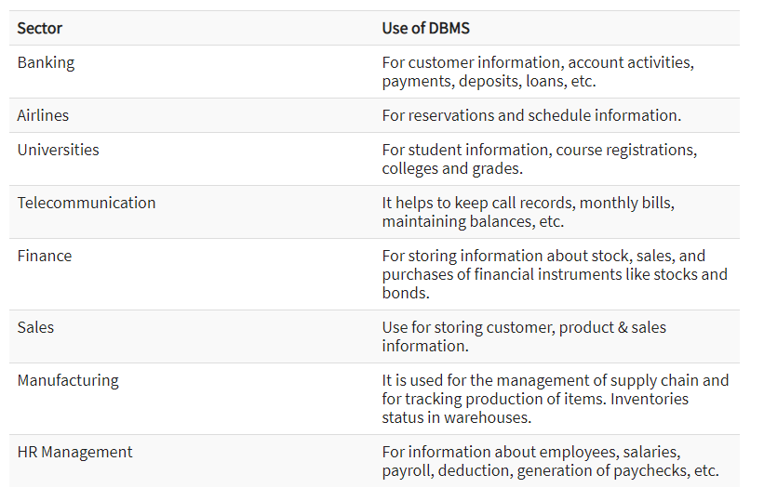
APPLICATIONS:

Slide 13
Advantages of a dbms:
DBMS offers a variety of techniques to store & retrieve data
DBMS serves as an efficient handler to balance the needs of multiple applications using the same data
Uniform administration procedures for data
Application programmers never exposed to details of data representation and storage.
A DBMS uses various powerful functions to store and retrieve data efficiently.
Offers Data Integrity and Security
The DBMS implies integrity constraints to get a high level of protection against prohibited access to data.
A DBMS schedules concurrent access to the data in such a manner that only one user can access the same data at a time
Reduced Application Development Time

Slide 14
DISADVANTAGES OF A DBMS
Cost of Hardware and Software of a DBMS is quite high which increases the budget of your organization.
Most database management systems are often complex systems, so the training for users to use the DBMS is required.
In some organizations, all data is integrated into a single database which can be damaged because of electric failure or database is corrupted on the storage media
Use of the same program at a time by many users sometimes lead to the loss of some data.
DBMS can't perform sophisticated calculations

Slide 15
COMPONENTS OF DBMS
Software
DBMS is primarily a software system that can be considered as a management console or an interface to interact with and manage databases.
The interfacing also spreads across real-world physical systems that contribute data to the backend databases.

Slide 16
COMPONENTS OF DBMS
Data
DBMS contains operational data, access to database records and metadata as a resource to perform the necessary functionality.
The data may include files with such as index files, administrative information, and data dictionaries used to represent data flows, ownership, structure, and relationships to other records or objects.

Slide 17
COMPONENTS OF DBMS
Procedures
While not a part of the DBMS software, procedures can be considered as instructions on using DBMS.
The documented guidelines assist users in designing, modifying, managing, and processing databases.

Slide 18
COMPONENTS OF DBMS
Database languages
These are components of the DBMS used to access, modify, store, and retrieve data items from databases; specify database schema; control user access; and perform other associated database management operations.
Types of DBMS languages include Data Definition Language (DDL), Data Manipulation Language (DML), Database Access Language (DAL) and Data Control Language (DCL).

Slide 19
COMPONENTS OF DBMS
Query processor
As a fundamental component of the DBMS, the query processor acts as an intermediary between users and the DBMS data engine in order to communicate query requests.
When users enter an instruction in SQL language, the command is executed from the high-level language instruction to a low-level language that the underlying machine can understand and process to perform the appropriate DBMS functionality.
In addition to instruction parsing and translation, the query processor also optimizes queries to ensure fast processing and accurate results.

Slide 20
COMPONENTS OF DBMS
Runtime database manager
A centralized management component of DBMS that handles functionality associated with runtime data, which is commonly used for context-based database access.
This component checks for user authorization to request the query; processes the approved queries; devises an optimal strategy for query execution; supports concurrency so that multiple users can simultaneously work on same databases; and ensures integrity of data recorded into the databases.

Slide 21
COMPONENTS OF DBMS
Database manager
Unlike the runtime database manager that handles queries and data at runtime, the database manager performs DBMS functionality associated with the data within databases.
Database manager allows a set of commands to perform different DBMS operations that include creating, deleting, backup, restoring, cloning, and other database maintenance tasks.
The database manager may also be used to update the database with patches from vendors.

Slide 22
COMPONENTS OF DBMS
Database engine
This is the core software component within the DBMS solution that performs the core functions associated with data storage and retrieval.
A database engine is also accessible via APIs that allow users or apps to create, read, write, and delete records in databases.

Slide 23
COMPONENTS OF DBMS
Reporting
The report generator extracts useful information from DBMS files and displays it in structured format based on defined specifications.
This information may be used for further analysis, decision making, or business intelligence.

Slide 24
Types of DBMS
Four Types of DBMS systems are:
Hierarchical database
Network database
Relational database
Object-Oriented database

Slide 25
Hierarchical DBMS
In a Hierarchical database, model data is organized in a tree-like structure.
Data is Stored Hierarchically (top down or bottom up) format.
Data is represented using a parent-child relationship.
In Hierarchical DBMS parent may have many children, but children have only one parent.

Slide 26
Network Model
The network database model allows each child to have multiple parents.
It helps you to address the need to model more complex relationships like as the orders/parts many-to-many relationship.
In this model, entities are organized in a graph which can be accessed through several paths.

Slide 27
Relational model
Relational DBMS is the most widely used DBMS model because it is one of the easiest.
This model is based on normalizing data in the rows and columns of the tables.
Relational model stored in fixed structures and manipulated using SQL.

Slide 28
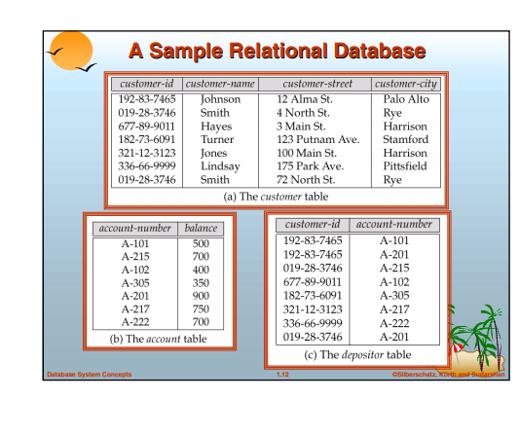
EXAMPLE

Slide 29
Object-Oriented Model
In Object-oriented Model data stored in the form of objects. The structure which is called classes which display data within it.
It defines a database as a collection of objects which stores both data members values and operations.

Slide 30
sql
SQL is a language which is used to interact with relational database management system.
SQL is used to interact with relational databases. We often refer relational database as SQL database.

Slide 31
WHAT IS SQL?
1. SQL stands for Structured Query Language, which is a standardised language for interacting with RDBMS (Relational Database Management System). Some of the popular relational database example are: MySQL, Oracle, mariaDB, postgreSQL etc.
2. SQL is used to perform C.R.U.D (Create, Retrieve, Update & Delete) operations on relational databases.
3. SQL can also perform administrative tasks on database such as database security, backup, user management etc.
4. We can create databases and tables inside database using SQL.

Slide 32
Types of Structured Query Language(SQL)
SQL is basically combination of four different languages, they are –
DQL (Data Query Language)
DQL is used to fetch the information from the database which is already stored there.
DDL (Data Definition Language)
DDL is used to define table schemas.
DCL (Data Control Language)
DCL is used for user & permission management. It controls the access to the database.
DML (Data Manipulation Language)
DML is used for inserting, updating and deleting data from the database.

Slide 33
WHAT IS A QUERY?
A Query is a set of instruction given to the database management system, which tells RDBMS what information you would like to get from the database.
For e.g. to fetch the employee name from the database table EMPLOYEE, we write the SQL Query like this:
SELECT employee_name from EMPLOYEE;

Slide 34
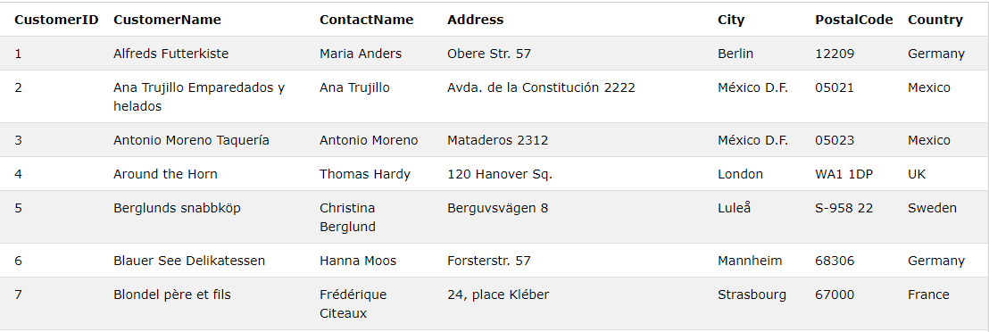
Example: SELECT * FROM Customers;

